Slide 1
Software Engineering-16CS54
Smart Ration Card System
Name :
Rishab V Arun
Siddharth Raikar
USN :
1RV17CS122
1RV17CS119
Guide -
Jyothi Shetty
Professor, RVCE
Department of Computer Science
RV College of Engineering®, Bengaluru

Slide 2
Problem Statement
To automate the public distribution system by introducing smart ration card which will reduce malpractices and increase transparency in the present system.

Slide 3
Purpose
India’s social commitment for providing food security for the poor and needy is answered through the strong network of more than 4.5 Lac Fair Price Shops (FPS) across the country. More than 150 million families purchase ration shop commodities every year. The Public Distribution system in India is however plagued with several malpractices which prevent the benefits from reaching the intended beneficiaries and also result in revenue loss for the Government. There is leakage and pilferage of food grains at each point of the supply chain - from procurement until distribution. It has also been seen that issuance of multiple ration cards to a single person prohibits the proper allocation of food grains to deserved beneficiary.

Slide 4
The manual maintenance of records for issuance of food grains at the Fair Price Shops helps in creating a supportive environment for the FPS owners to indulge in malpractice. Keeping in mind the above areas, it is crucial to strengthen the PDS to ensure adequate supplies, reasonable subsidies and efficient delivery of subsidized food.

Slide 5
Intended Users
The software is meant to be used by ration card holders (BPL and APL families), distributors (owners of Fair Price Shops (FPS)) and the government (admin). Since most of the beneficiaries of the public distribution system are from rural families it is necessary that the software is easy to use and understandable to people who have little knowledge about technology.

Slide 6
Objective
The Planning commission had stated in its report that:
‘For every Rs 4 spent on PDS only Rs 1 reaches the poor’
‘57 % of PDS food grain does not reach the intended people’
The main focus of this project is to bring order to the current system by eliminating all these problems and providing a secure environment for transactions to take place. It is also a prospect for Digital India. The automation of the current ration system will also speed up the process and thus help cope up with increasing population.

Slide 7
Scope
The proposed project is meant to be implemented at the bottom level of the public distribution system (i.e at the FPS level). The transaction records can be atomized at this level, the system can be further expanded to other levels of the PDS to increase transparency and make sure that the ration reaches the needful.

Slide 8
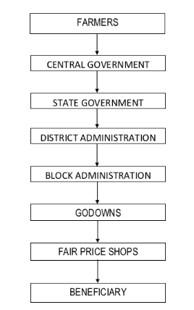
Current System Overview
In the present Public Distribution System, paper ration card are issued to eligible families. Commodities like wheat, sugar, rice and kerosene oil etc. are being offered at subsidized prices as per the eligibility recorded in the ration card. The record of eligibility and transactions is maintained manually both in the ration cards and the register maintained in the Fair Price Shop (FPS).
The food grains are procured from the farmer and is later distributed at different levels of the system based on the need.

Slide 9
Current system challenges
The most serious flaw regarding the system at present is the lack of transparency and accountability in their functioning.
There is a huge diversion of commodities from the PDS due to misuse and duplication of ration cards. According to some estimates around 30% of the food grains and other commodities allocated for poor families do not reach them.
According to 2010 report by a Supreme Court Committee headed by former Justice D.P. Wadhwa, India has 23 million ―ghost ration cards in fictitious names and around 121 million deserving poor are deprived of subsidized food. Each fake card causes Rs. 8200 loss of the annual subsidy.

Slide 10
A number of instances where benefits are being availed in the names of rightfully entitled families without their knowledge. This shadow ownership is possible due to inefficiency in ration card issuance, distribution and record keeping.
Pilferage – PDS food grains find way to the market and all the allot do not reach the eligible person.
There is no central monitoring system at the FPS level.
The ration cards are not based on RFID technology and hence can be faked.
People are not aware of any new schemes introduced by the government and many families eligible for ration card have not applied for the ration card.

Slide 11
The FPS issues the goods to the dealer as per the type and number of people mentioned in their respective Ration Cards. The two main categories of Ration Cards are Above Poverty Line (APL) and Below Poverty Line (BPL). Each FPS maintains a bill book into which the Bills of every PDS sale is made.
At the end of the month, these records are forwarded to the Civil Supplies Department which in turns maintains records of the distribution done to the people. Subsequent stocks that are left over at any FPS are carried forward to the next month. In the next month , the same FPS receives lesser quantity. In this way, Only manual records are maintained but not computerized ones. This results in significant gaps in the updating of stock status on the government website.

Slide 12
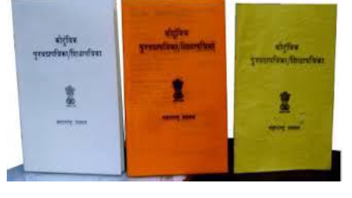
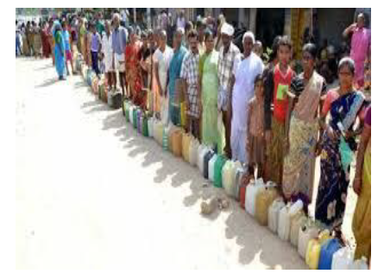
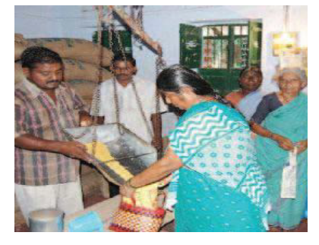

Slide 13
Proposed System
The proposed system replaces the manual work in FPS. The main objective of the designed system is the automation of FPS to provide transparency, preventing leakages, curbing corruption and ensuring need based allocation in the Public Distribution System. The proposed automatic FPS for public distribution system is based on RFID technology that replaces conventional ration cards.
Transparency will be created by computerizing all the transactions that take place in the FPS.
Automation of the system will also make the process faster and thereby make it available to more people.
By storing individual transactions in a centralized database can effectively improves PDS and ensure fare distribution of commodities.
By allowing the users to lodge complains and give feedbacks the malpractices of the FPS can be kept at check.

Slide 14
Functional Requirements
Ration card user details (personal details like Aadhar no, family info) are stored in a centralised and secure database.
Verification of ration card is done using RFID Reader installed at the center.
The ration card customer gets a bill having the details of his transaction at the FPS.
Stocks are updated by the FPS as stocks are received.
The system allows the user to add balance to his ration card account.
The system allows the user to shop for ration limited by his monthly quota assigned as per his family requirement.
Make sure there is no malpractice done during distribution of groceries and the ration reaches only the ration card holder’s family

Slide 15
The ration card user should be allowed to lodge complains/give feedbacks.
The ration card user can check his previous transactions.
The FPS owner can check the transactions that have happened in his shop.
The admin (government) is able to add/remove/update distributors and ration card users.
The admin is able to monitor the working of the FPS.
The admin is able to issue circulars and give inspection reports to FPS.

Slide 16
Non Functional requirements
Performance Requirements: There should be least latency while accessing the stock database or while performing any actions. The stock needs to be updated within a day after it is loaded in the FPS and when the card holder purchases the groceries the database must be updated instantaneously with a delay not more than 2 seconds.
Safety Requirements: Since the software is web based, there shouldn’t be any glitches in using it, mainly while making transactions or updating stock. The user transaction and account details should be secured and the developers should maintain the website regularly to prevent bugs.

Slide 17
Security Requirements: For the ration card users to register the user will have to provide personal details like Aadhar card details. The database also stores the user’s personal details like number of family member, ration card category, etc. These details should not be disclosed to the public and should be secured. No backdoor entry into the system should be allowed and non ration card holders should not be allowed to withdraw ration in place of ration card holders.
Software quality attributes:
Availability: The software must be easily accessible through online portal.
Adaptability: The software must integrate with the RFID modules and the RFID sensor.
Flexibility: The details of the ration card holders and FPS should be modifiable.
Maintainability: The database of the software containing large amount of data should be maintained.
Scalability: There are millions of ration card users so the website should be able to millions of transactions and users simultaneously.
Portability: Since, it’s a web based application it can be opened in any web browser.

Slide 18
Use Cases
1) Use Case 1: Login
Primary Actor: User, FPS owner, Admin (Government)
Main Scenario:
The Primary actor opens the automated ration card system website.
The Primary actor goes to the login page.
The Primary actor provides the required credentials in the form.
The Primary actor can now access the features available to him
Alternate Scenario:
Scenario 1: The credentials provided are wrong, the primary actor is requested to provide the right details.
Scenario 2: Network failure due to no internet access. The Primary actor won’t be able to login.

Slide 19
2) Use Case 2: Withdraw Ration
Primary Actor: Ration Card User
Main Scenario:
The User after logging in chooses withdraw ration option.
The User chooses the ration he needs to withdraw and the quantity of the ration.
The User pays the money and buys the ration.
The Users ration quota is updated.
Alternate Scenario:
Scenario 1: The user does not have any ration quota left, he will be unable to buy ration.
Scenario 2: Network failure due to no internet access. The User won’t be able to withdraw ration.

Slide 20
3) Use Case 3: View Ration Card details
Primary Actor: Ration Card User
Main Scenario:
The User after logging in chooses ration card details option.
The User is able to access all the details about his family, ration card quota left, etc.
Alternate Scenario:
Scenario 1: Network failure due to no internet access. The User won’t be able to see his ration card details

Slide 21
4) Use Case 4: Modify Stock
Primary Actor: FPS owner
Main Scenario:
The FPS owner after logging in chooses modify stock option.
The FPS owner can add stock as per the requirement/scenario.
The FPS can choose the save option and the database gets updated.
Alternate Scenario:
Scenario 1: Network failure due to no internet access. The FPS won’t be able to modify his stock details.

Slide 22
5) Use Case 5: View Transaction Details
Primary Actor: FPS owner
Main Scenario:
The FPS owner after logging in choose view transaction details option.
The FPS owner can get the transaction details of the stock he has in his shop.
Alternate Scenario:
Scenario 1: Network failure due to no internet access. The FPS won’t be able to see the transaction details.

Slide 23
6) Use Case 6: Add/Modify FPS details
Primary Actor: Admin
Main Scenario:
The Admin after logging in can choose to add/modify the FPS details.
The Admin can choose to add/update/delete a FPS.
The admin can choose to save the alteration.
The admin can monitor the FPS and issue inspection reports
The admin can also send circulars to the FPS.
Alternate Scenario:
Scenario 1: Network failure due to no internet access. The Admin won’t be able to modify FPS details.

Slide 24
7) Use Case 7: Add/Modify Ration Card Holder
Primary Actor: Admin
Main Scenario:
The Admin after logging in can choose to Add/modify ration card holders.
The Admin can select the ration card holder by his id number and modify his details or add/remove ration card holders.
Alternate Scenario:
Scenario 1: Network failure due to no internet access. The Admin won’t be able to add/modify the ration card holder.

Slide 25
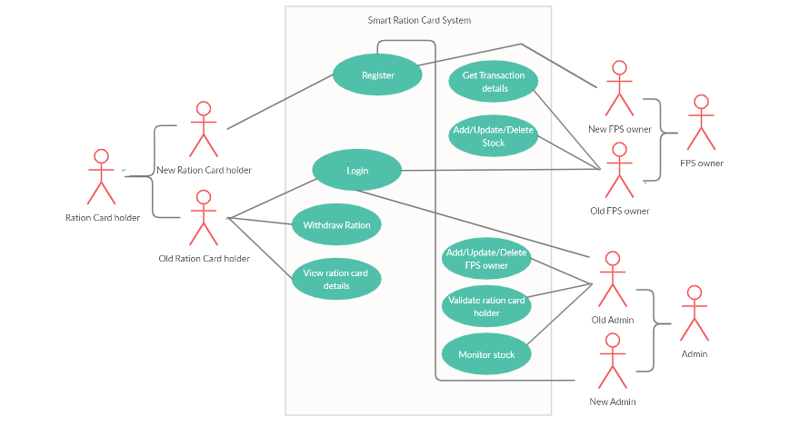
_{Add stock}
Add

Slide 26
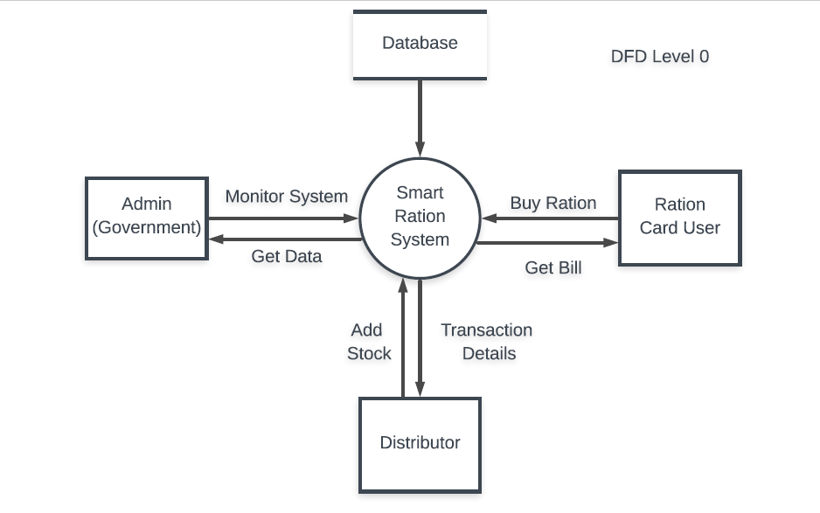
Data Flow Diagram

Slide 27
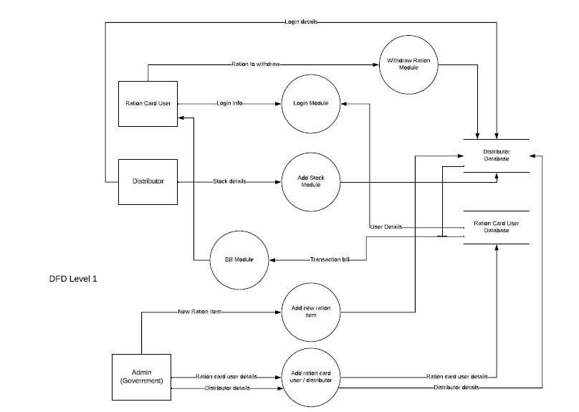

Slide 28
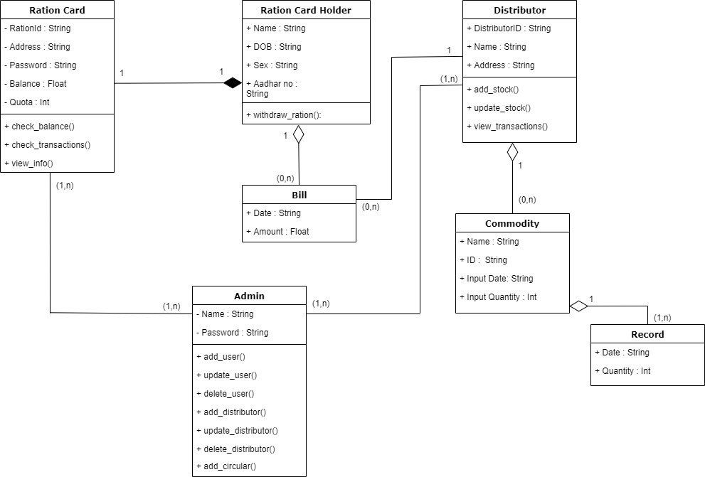
Class Diagram

Slide 29
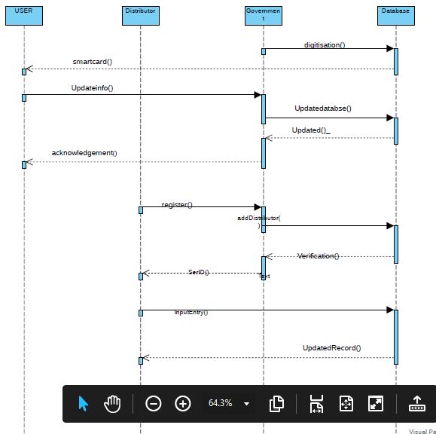
Sequence diagram

Slide 30
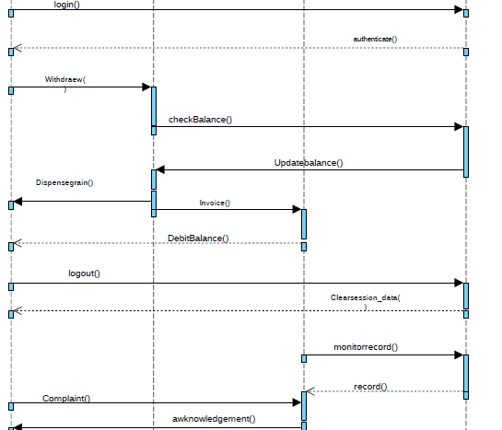

Slide 31
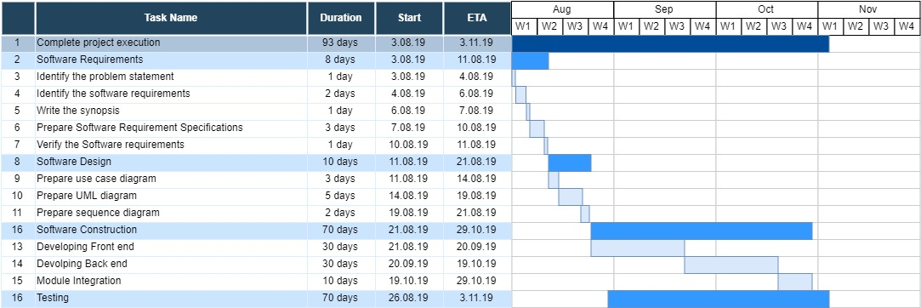
Activity/Gantt Chart

Slide 32
_{IMPLEMENTATION}
_{TOOLS USED FOR DEVELOPMENT:}
* Database management: MySQL Shell and MonogoDb compass
* Interface and script development: Microsoft Visual Code
* RFID prototype development: NodeMCU, ArduinoIDE
_{TOOLS USED FOR DOCUMENTATION:}
* Software Requirement Specifications: Microsoft Word
* Use cases Diagram: Lucid chart
* Gantt chart, Activity chart: Draw.io
* Sequence Diagrams, DFD: Lucid chart
_{* Class Diagram: Draw.io}

Slide 33
Unit Testing
Unit testing is a software development process in which the smallest testable parts of an application, called units, are individually and independently scrutinized for proper operation. Unit testing is often automated but it can also be done manually.
Firstly unit test is carried for user and distributor login to check if he/she is valid or not using the id and a password assigned to them to login into the software package. The next unit testing is carried out for RFID tag and the reader, to check if the RFID reader is able to read 32bit id of the RFID tag. Then the unit testing is carried out for the stock update and withdraw ration transaction.

Slide 34
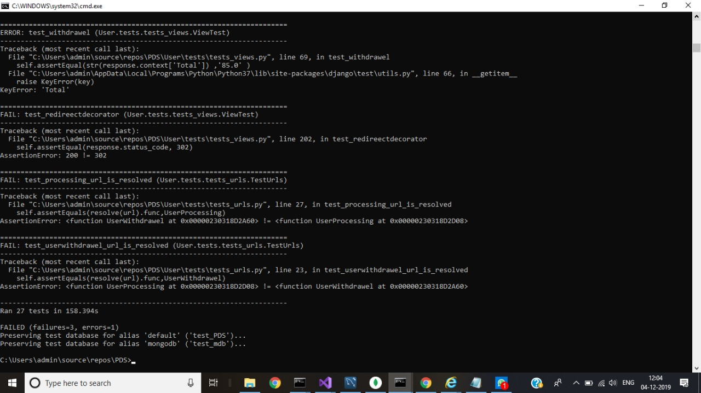

Slide 35
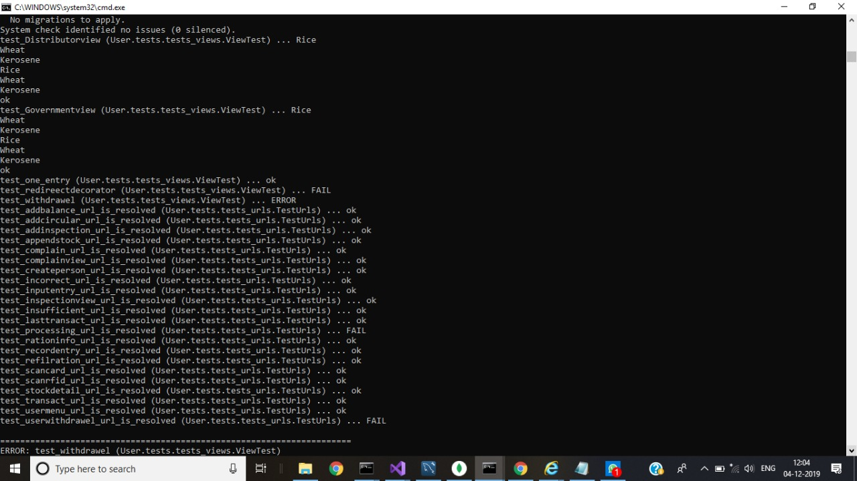

Slide 36
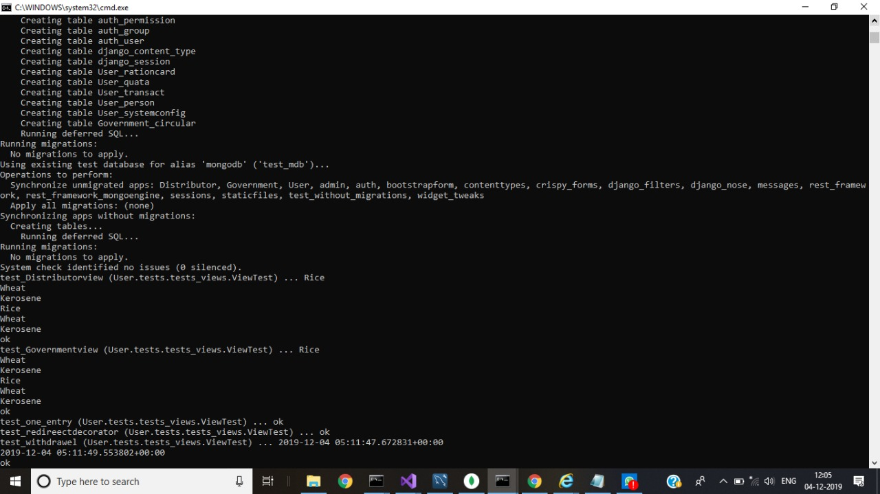

Slide 37
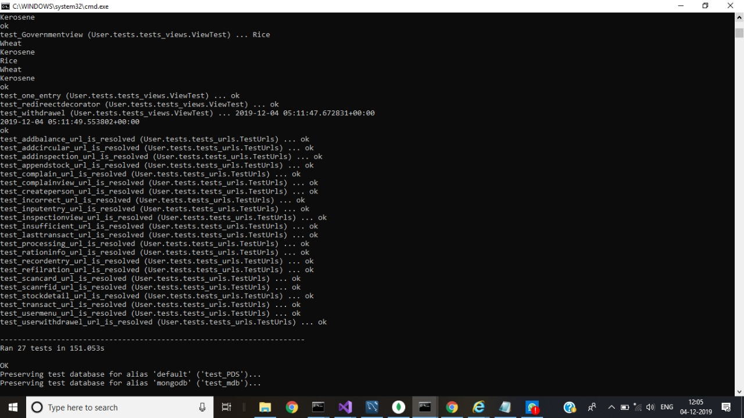

Slide 38
Pair wise testing
USERNAME | PASSWORD | RNO | CATEGORY | EMAIL | PIN
VALID | CORRECT | NOTEQUAL_4 | APL | VALID | INTEGER
INVALID | INCORRECT | EQUAL_4 | BPL | INVALID | NOT_INTEGER
VALID | INCORRECT | EQUAL_4 | BPL | VALID | INTEGER
VALID | CORRECT | EQUAL_4 | APL | INVALID | NOT_INTEGER
INVALID | INCORRECT | NOTEQUAL_4 | APL | VALID | NOT_INTEGER
INVALID | CORRECT | NOTEQUAL_4 | BPL | INVALID | INTEGER

Slide 39
GENDER | DOB | PHOTO
OTHER | TIMESTAMP | JPEG
FEMALE | TIMESTAMP | JPG
MALE | NOT_TIMESTAMP | JPEG
MALE | TIMESTAMP | PNG
FEMALE | NOT_TIMESTAMP | JPEG
MALE | NOT_TIMESTAMP | JPG
FEMALE | NOT_TIMESTAMP | PNG
OTHER | NOT_TIMESTAMP | PNG
OTHER | TIMESTAMP | JPG

Slide 40
CATEGORY | RICE | WHEAT | KEROSENE | BALANCE
BPL | LESS_THAN_MAX_LIMIT | LESS_THAN_MAX_LIMIT | LESS_THAN_MAX_LIMIT | INSUFFICIENT
BPL | MORE_THAN_MAX_LIMIT | LESS_THAN_MAX_LIMIT | MORE_THAN_MAX_LIMIT | SUFFICIENT
APL | EQUAL_MAX_LIMIT | EQUAL_MAX_LIMIT | NOT_VALID | SUFFICIENT
BPL | MORE_THAN_MAX_LIMIT | MORE_THAN_MAX_LIMIT | LESS_THAN_MAX_LIMIT | INSUFFICIENT
APL | LESS_THAN_MAX_LIMIT | MORE_THAN_MAX_LIMIT | NOT_VALID | INSUFFICIENT
BPL | EQUAL_MAX_LIMIT | EQUAL_MAX_LIMIT | LESS_THAN_MAX_LIMIT | INSUFFICIENT
BPL | LESS_THAN_MAX_LIMIT | MORE_THAN_MAX_LIMIT | MORE_THAN_MAX_LIMIT | SUFFICIENT
BPL | EQUAL_MAX_LIMIT | MORE_THAN_MAX_LIMIT | EQUAL_MAX_LIMIT | SUFFICIENT
BPL | EQUAL_MAX_LIMIT | LESS_THAN_MAX_LIMIT | MORE_THAN_MAX_LIMIT | INSUFFICIENT
BPL | MORE_THAN_MAX_LIMIT | LESS_THAN_MAX_LIMIT | EQUAL_MAX_LIMIT | INSUFFICIENT
BPL | LESS_THAN_MAX_LIMIT | EQUAL_MAX_LIMIT | EQUAL_MAX_LIMIT | SUFFICIENT
APL | MORE_THAN_MAX_LIMIT | LESS_THAN_MAX_LIMIT | NOT_VALID | SUFFICIENT
BPL | MORE_THAN_MAX_LIMIT | EQUAL_MAX_LIMIT | LESS_THAN_MAX_LIMIT | SUFFICIENT
BPL | LESS_THAN_MAX_LIMIT | EQUAL_MAX_LIMIT | MORE_THAN_MAX_LIMIT | SUFFICIENT
BPL | LESS_THAN_MAX_LIMIT | MORE_THAN_MAX_LIMIT | NOT_VALID | INSUFFICIENT

Slide 41
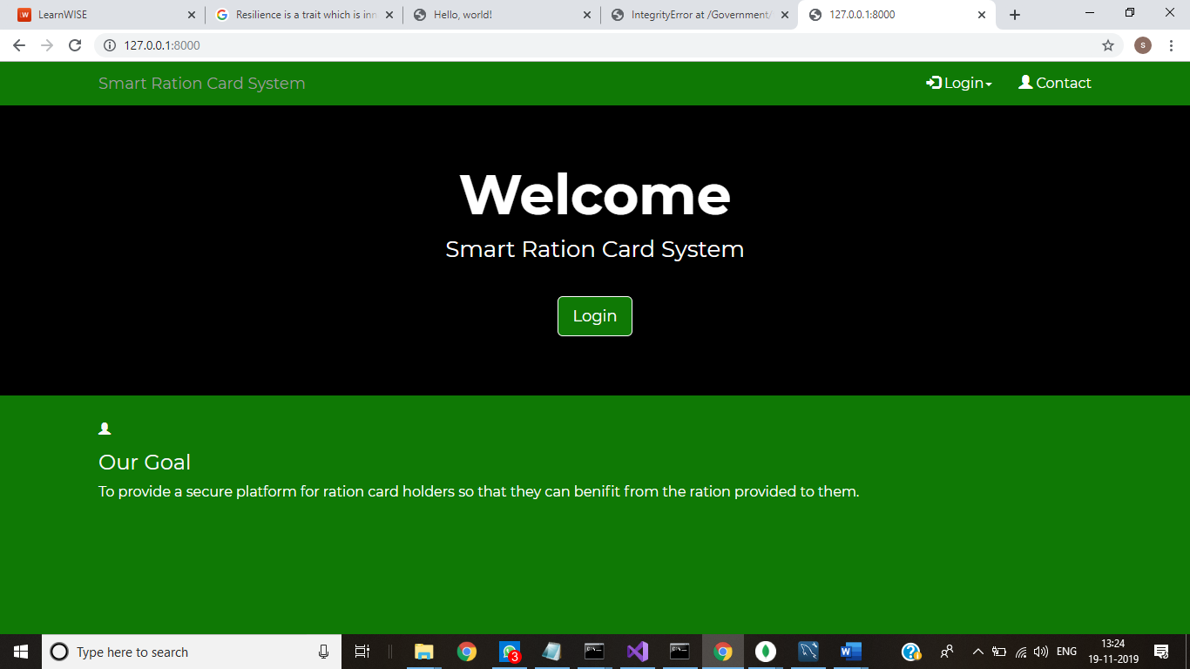

Slide 42
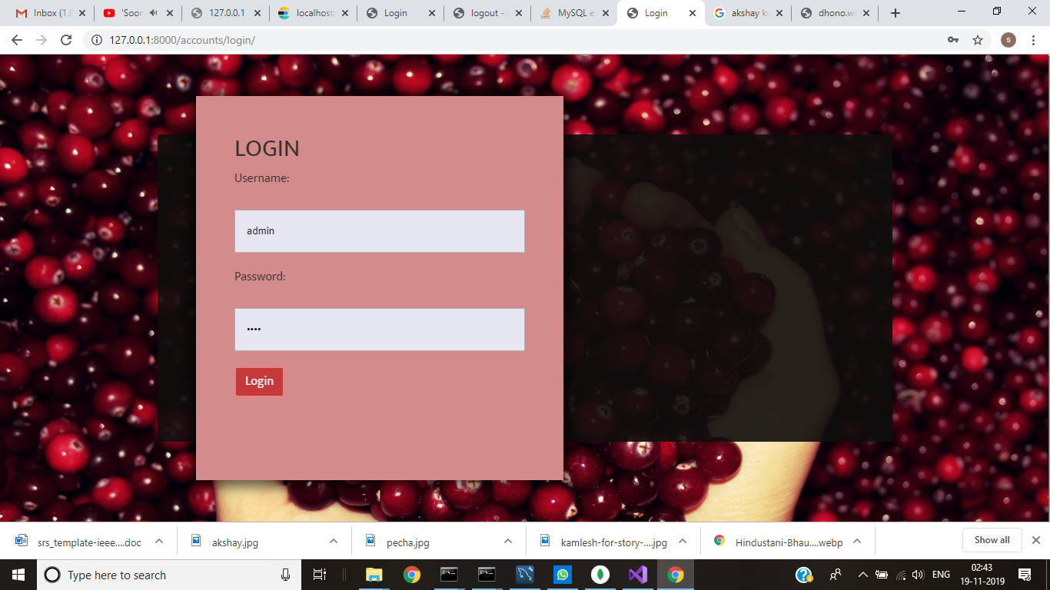

Slide 43
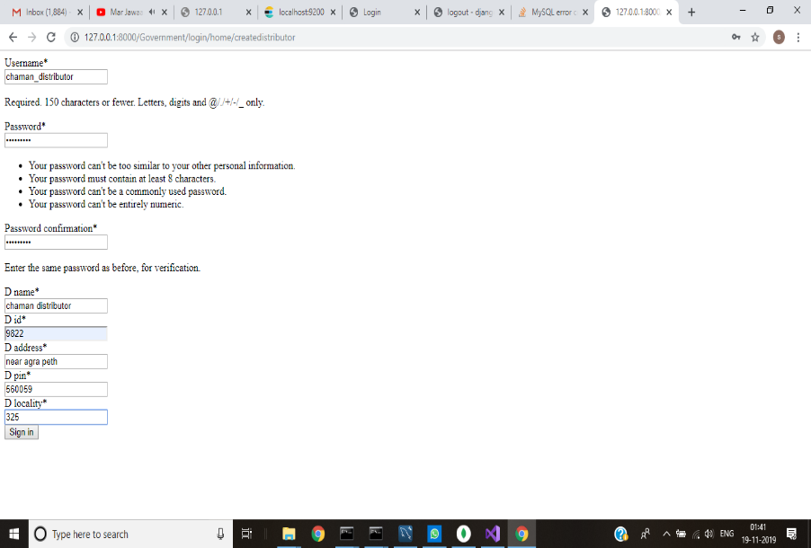

Slide 44
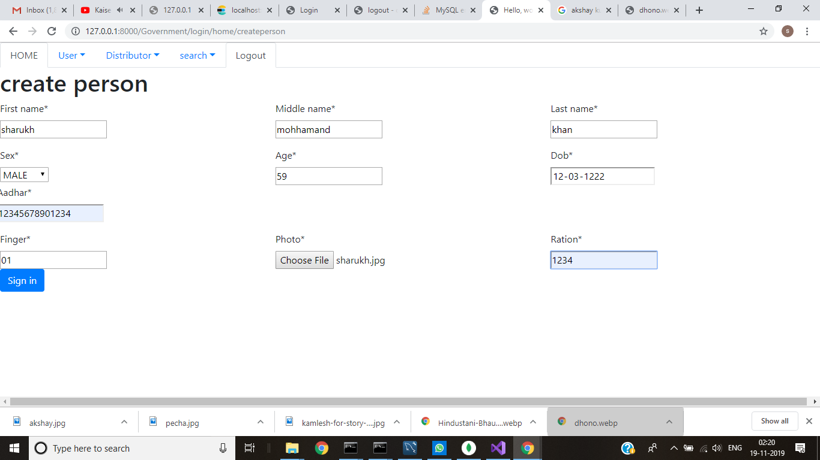

Slide 45
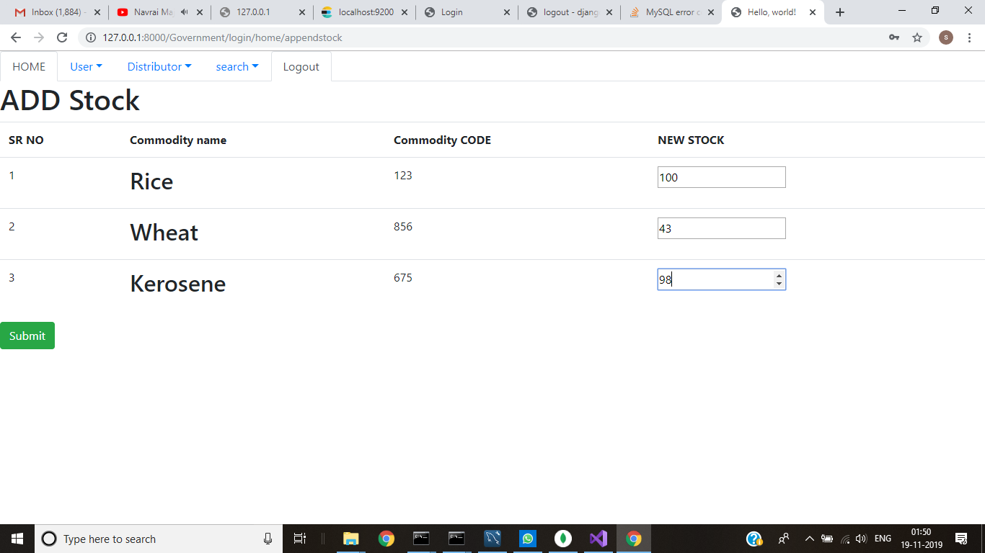

Slide 46
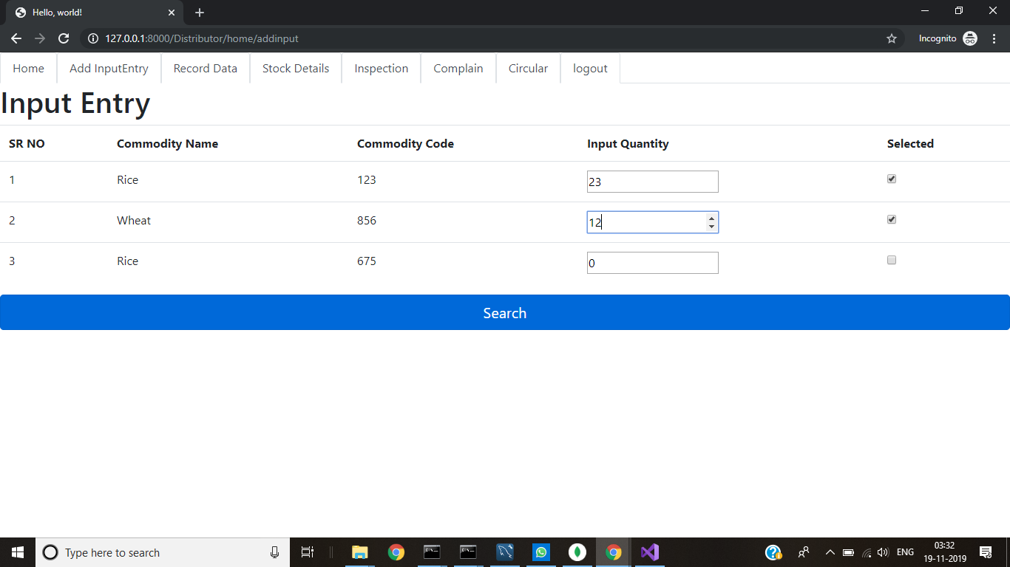

Slide 47
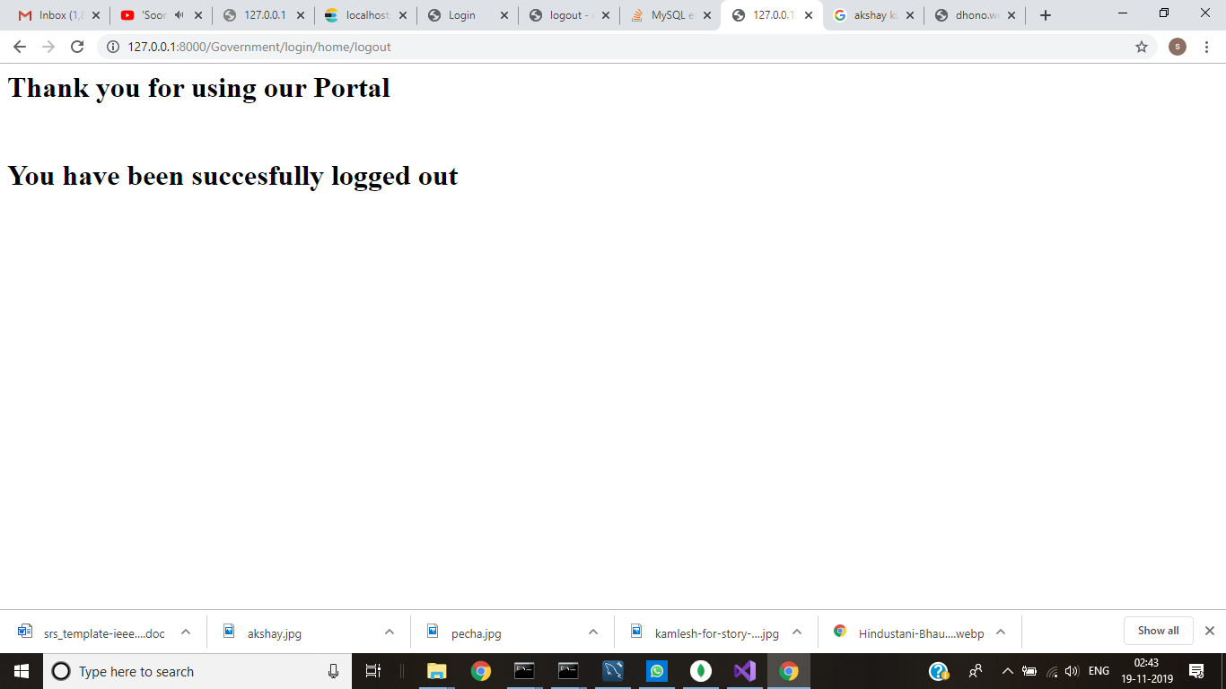

Slide 48
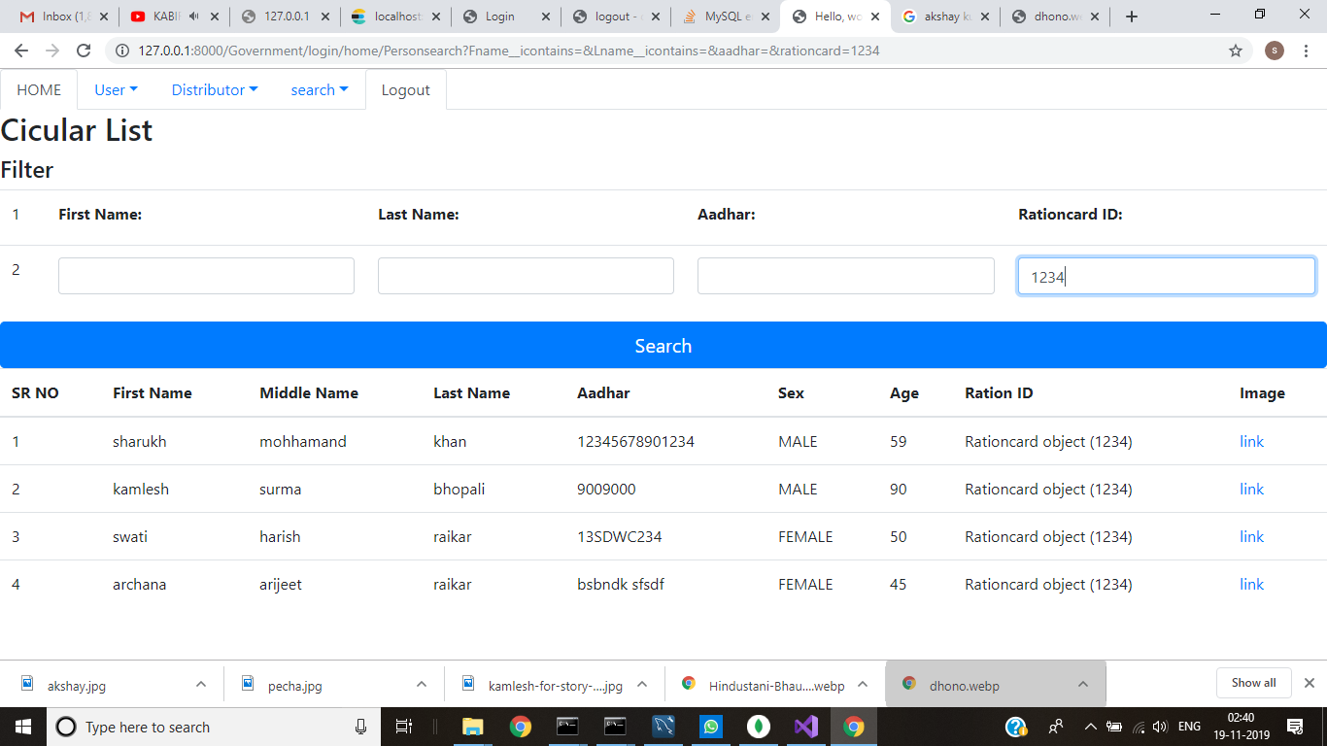

Slide 49
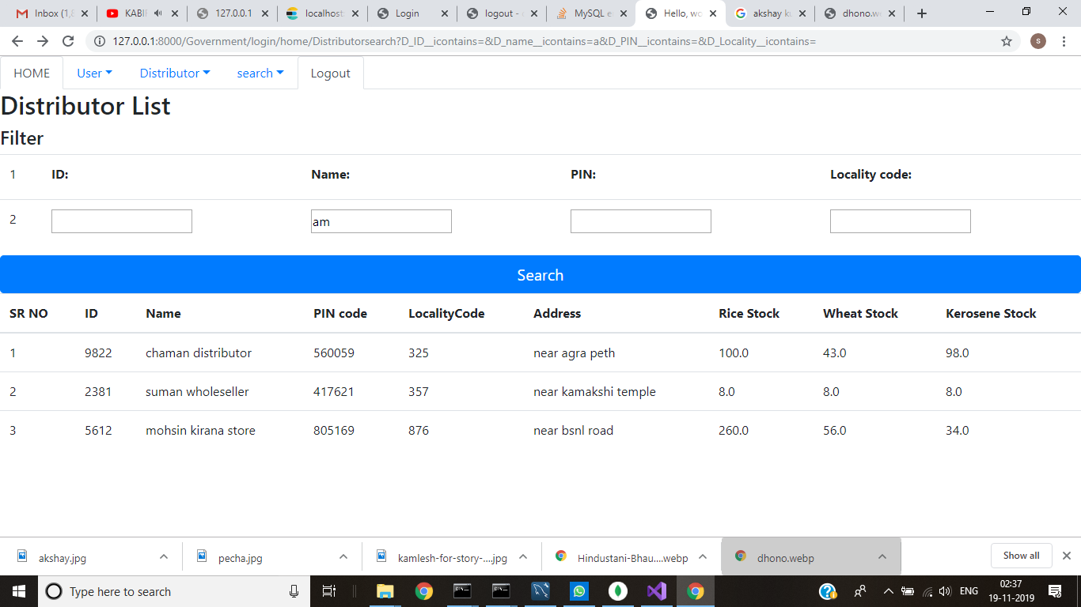

Slide 50
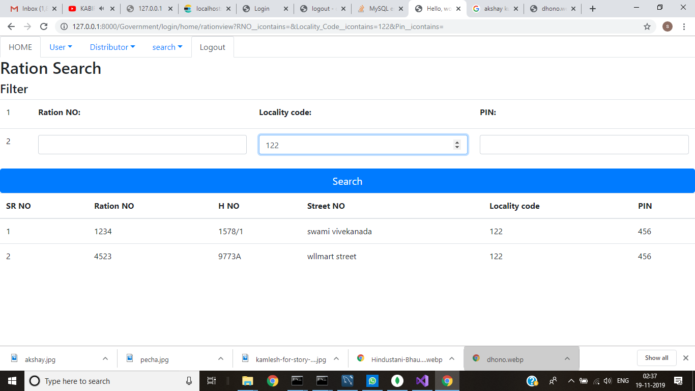

Slide 51
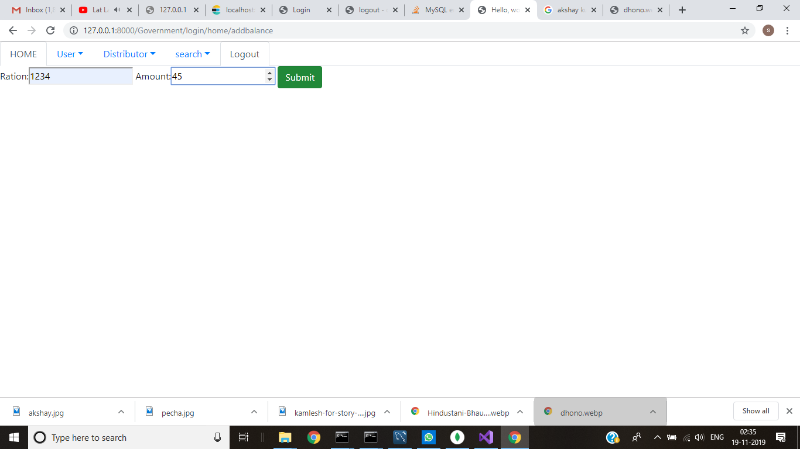

Slide 52
CONCLUSION
Ration card forgery is one of the most difficult challenges faced by the food distribution department. There may be chances where ration is not delivered to the beneficiaries and false records are noted down, regarding the delivery by distributor. And there is probability of him selling the commodities in open market with extra profit etc. Therefore, the proposed system is more secure and transparent then the normal existing system. Entry of fallacious data in the ration database can be avoided with the use of smart cards and additional security is provided by computerized system and centralized database. The distributor is only responsible for entering the quantity of the commodities. Maintaining the database is also helpful for sending messages to the beneficiaries about the ration delivery. It is anticipated that the proposed project will create transparency in public distribution system as the work becomes automatic and also it makes the system free from irregularities.

Slide 53
FUTURE WORK
For better understanding, an interface and website can be made available in different languages (regional languages).
For the ease of use, an application can be built for the same.
Automatic weighing system can be implemented at the FPS or godown.
The ration card users can be alerted if the commodities are available in the FPS or not.

Slide 54
REFERENCES
[1] Dhanashri Pingale, Sonali Patil, Nishigandha Gadakh, Reena Avhad, Gundal S.S “Web
Enabled Ration Distribution and Corruption Controlling System”, International Journal of
Engineering and Innovative Technology (IJEIT), Volume Issue 8, February 2016.
[2] Shivbhakt mhalsakant Hanmant, Suraj V.S, Moresh Mukhedkar, “Automization of
Rationing System”, International Journal of Computational Engineering & Management
(IJCEM), Volume 7, Issue 6, November 2014.
[3] S.Sukhumar, K.Gopinathan, S.Kalpanadevi,, P.Naveenkumar, N.Suthanthira Vanitha,,
“Automatic Rationing System Using Embedded System Technology”, International Journal of
Innovative Research in Electrical, Electronics, Instrumentation and Control Engineering, Vol. 1,
Issue 8, November 2017.
[4] Rajesh C. Pingle and P.B. Borole, Automatic Rationing for Public Distribution System
(PDS) using RFID and GSM Module to prevent Irregularities, HCTL Open Int. of Technology
Innovations and Research Volume 2, March 2018.

